Slide 1
COMP 1537
CSS II (animation, layouts, media queries)

Slide 2
Transforms (1/2)
CSS can apply the following:
transform (move)
rotate, rotateX, rotateY
scale, scaleX, scaleY
skew, skewX, skewY
Matrix (all-in-one), matrix(a, b, c, d, e, f) where:
a - scale x
d - scale y
b - skew x
c - skew y
e - translate x
f - translate y

Slide 3
Transforms (2/2)
Also:
Perspective
Large values = less perspective (e.g., 1600px)
Small values = huge distortion (e.g., 60px)
Can use in conjunction with other CSS functions (e.g., rotateY)
Links (libraries that use JavaScript + CSS + HTML):
https://github.com/tobiasahlin/SpinKit
https://github.com/juliangarnier/anime/#demos-and-examples
And general talk about it:
https://css-tricks.com/almanac/properties/t/transform/
This is all more than we have time for unfortunately – so try these on your own ☺

Slide 4
Animations in CSS 3 (1/2)
Quite useful feature set for creating animations:
Key frame, color/transparency changes, size/position changes, delays, timing
You declare an animation specifying key frames:
Then you bind the animation using selectors and the animation property:
@keyframes anim1 { from {background: red;} to {background: yellow;} }
div { animation: anim1 5s; }

Slide 5
Animations in CSS 3 (2/2)
Properties:
@keyframes: specifies the animation
animation: short hand for specifying all animation properties
animation-delay: delay in seconds before animation starts
animation-direction: normal, reverse, alternate, alternate-reverse
animation-duration: how many seconds the animation takes to complete
animation-fill-mode: styles the animation has when not playing
animation-name: the name of the animation
animation-iteration-count: times the animation should play
animation-play-state: running, paused

Slide 6
History of Web Layouts (1/3)
HTML on its own is technically responsive
The content fills the browser content window
And flows down with scrolling when needed
But this was … boring – only one column of content
Tables were used for creating layouts
Why? Because when HTML first came out there was no CSS
CSS 1 didn't arrive until late 1996
So tables helped create:
Headers, footers, non-standard layouts, multi-column content

Slide 7
History of Web Layouts (2/3)
People in the print industry were used to a specific/fixed size
HTML changed that notion of a fixed size
Again, HTML without CSS offers a fluid layout
Fixed size is easier on the designer – one size fits all
Easier and greater amount of control for designers
However this is horribly impractical today because
We have many different sized devices
With many different supported resolutions

Slide 8
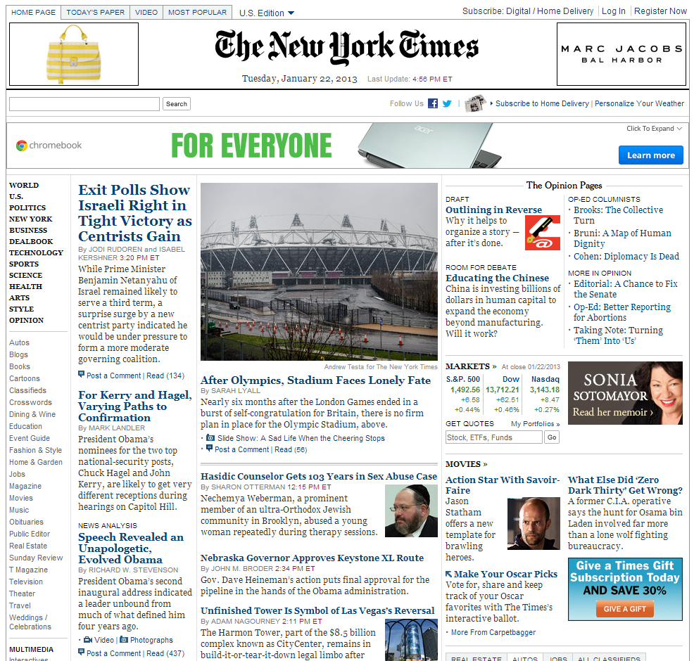
Can You Read This?

Slide 9
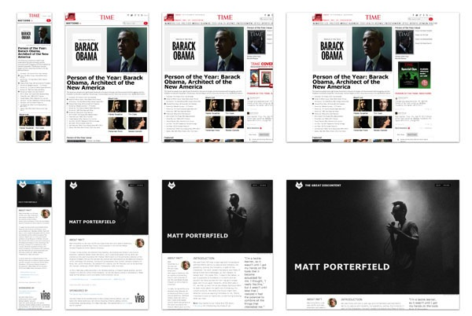
Responsive – multiple layout designs
Much better!
But more work ☹

Slide 10
Current Web Layout Strategies (1/4)
Fixed layout
Uses absolute values (e.g., pixels) to set the size of containers
E.g., footers/header width/height, column width, logo dimensions
Are specific to a particular resolution (usually width)
Good:
Sometimes requirements for content have to be a specific size
E.g., ads, banners, images, icons
Content easier to manage
Bad:
Can cause horizontal scrolling, which is bad
Layout doesn't resize to browsers

Slide 11
Current Web Layout Strategies (2/4)
Liquid layout
Using percentages for all containers
Including headers, footers, multi-columns
Stretches and shrinks accordingly
Although in some cases, content can overlap if too big for the container width
Good:
Resize with the browser, don't cause horizontal scrolling
Bad:
Don't solve all layout problems, can cause content to overlap

Slide 12
Current Web Layout Strategies (3/4)
Responsive Web Design (RWD)
Uses media queries – more on this later
Flexible images, fluid compartments are sized based on percentages
Info/content for every device is included
All assets are downloaded regardless of whether they are used (or not)
Single template for all devices
Good:
One site, one set of downloads, unified design
Bad:
Low bandwidth devices still download all content
E.g., large 1 MB images

Slide 13
Current Web Layout Strategies (4/4)
Adaptive Web Design (AWD)
Uses client-side (browser) or server side code
To detect device (e.g., tablet, desktop, mobile phone)
Serves separate HTML depending on device
Several templates are created for standard sizes
Good:
Each type of device gets its own content
E.g., low bandwidth content for mobile phones
Bad:
Each device has its own site – design/development is costly, time consuming

Slide 14
Layout Meta Data
Remember the meta element?
Use the:
name attribute with the viewport value and the
content attribute (e.g., width=device-width, initial-scale=1)
width/height: width/height of the virtual viewport of the device
device-width/height: physical width/height of the device's screen
minimum-scale: minimum amount the visitor can zoom on the page (1.0 = no zoom)
maximum-scale: maximum amount the visitor can zoom on the page (1.0 = no zoom)
user-scalable: allows device to zoom in/out, values = 'yes' or 'no'
This is used when doing responsive designs
Don't use if you're not using media queries!

Slide 15
Display Property Values (1/2)
Remember the CSS display property?
It allows us to override element display characteristics
Block level elements take up the whole line
E.g., div, h1 – h6, p, form, header, footer, section
Inline level elements only take up as much space as necessary
E.g., span, a, img
You can change the default value of any elements' display property

Slide 16
Display Property Values (2/2)
Display value properties:
hidden: make element invisible (i.e., not displayed in browser)
inline: only as big as the content
block: take up entire line
list-item: list items for lists
inline-table: table but inline instead of block
table: table (i.e., whole line)

Slide 17
Float and Clear
float can be set to left or right
When we float, we change the behavior of the floated element
If we do this to an inline element (such as span)
It removes it from the inline text and places it in a block of its own
Similar to moving a drawn component from a page and onto a transparency sheet
clear can be set to left, right, none or both
This specifies which sides (of an element) allow for other floating elements to be placed against it
kind of like a detracting field
Nothing is allowed to 'touch' the side specified (e.g. left)
float: right;
float: left;

Slide 18
CSS Grid (1/2)
The Grid (not the English electronic dance group from the 1990s) in CSS:
Allows a container (e.g., body, div, section, etc.) to be divided into rows & columns
Much like a spreadsheet
Has many different ways to specify the rows and columns such as:
Gap between rows & columns
Repeating attributes
Absolute vs relative units of measure (e.g., percentages/viewport w/h vs fractional units)
Labeled areas (e.g., header, footer, main, menu)

Slide 19
CSS Grid (2/2)
For this course, we’ll focus on using the following CSS properties:
grid-template-columns, grid-template-rows – for the container
grid-column, grid-row – for the elements in the container
Using the format:
index / span number_of_spanned columns/rows
E.g., 3 / span 2, which means: start at column/row 2 and span 2 rows – starting at row 2
Please read through the following web sites for documentation/tutorials:
Mozilla Developer Network:
https://developer.mozilla.org/en-US/docs/Web/CSS/CSS_Grid_Layout
CSS Tricks:
https://css-tricks.com/snippets/css/complete-guide-grid/

Slide 20
Media Queries (1/2)
New to CSS 3
Allow conditions to be made on rendering
Use the @media annotation and specify:
min-width, max-width, min-height, max-height
device-aspect-ratio, min-device-aspect-ratio, max-device-aspect-ratio
only, not, all, and
Use the @media to specify:
print, screen, speech, all
tv, tty, projection, handheld, braille, embossed are deprecated since CSS 2.1

Slide 21
Media Queries (2/2)
Media queries can be placed in:
CSS file, CSS style element, link element
Examples:
@media (min-width: 700px) { ... }
@media (min-width: 700px) and (orientation: landscape) { ... }
@media print and (min-width: 700px) and (orientation: landscape) { ... }
@media screen and (min-aspect-ratio: 1/1) { ... }
@media screen and (device-aspect-ratio: 16/9), screen and (device-aspect-ratio: 16/10) { ... }

Slide 22
Web Layout /Design Strategies
Fixed layout
Poor choice which assumes one size fits all
Liquid layout
Nice start, lays out compartments on percentage
Adaptive layout
Chooses several templates for known dimensions
Responsive layout
One layout, media queries for ranges, liquid

Slide 23
Best Practices
Create multiple layout choices with media queries:
Different font sizes (and possibly different fonts) based on resolution
Collapsed menus for smaller devices
Different numbers of columns based on the width of the screen
Optional headers and footers if screen size is too small to support both
Changes in the order of content displayed
Use percentages for layouts as much as possible
You may not have a choice on some things (e.g., images, ads, videos)
Try to use as little bandwidth as possible
So compress images/video/other content as much as possible

Slide 24
Example – Video Element
Use HTML5 video element
Can add controls, loop, poster
Use CSS to resize – not width and height attributes
Tricks, set:
display to 'block'
margin to '0 auto' in order to center
width to value, height to 'auto'
Video element can even have:
Multiple sources (to support multiple devices)
Track elements, which can be used for captions, subtitles, etc.

Slide 25
Example – Audio Element
Use HTML5 audio element
Can add controls, loop
Use CSS to resize – not width and height attributes
Tricks, set:
Create a div element, put img, audio elements inside
Set margin: 0 auto
Set div (the audio container) display to 'table'
Set div's img display to 'block'
Creates a player that has a still image
This could be replaced by a canvas visualization

Slide 26
Example – Liquid Image Gallery
Image gallery thumbnails consist of:
A div container that has
div elements that have
An anchor element which has an image inside of it
A heading (e.g., h3)
A paragraph for a description of the image
Center div container with margin: 0 auto
Float all div elements that contain the image, heading, paragraph
Ensure that img element has it's display set to 'block'

Slide 27
Example – Responsive Image Gallery
Use media queries, set max width
Like previous example, create div containers, where:
A div box holds:
Another div which holds
An img, and another div – which holds the text
Using media queries, use resolutions to choose widths of div boxes
E.g.,
> 1290, 20% for each box so 5 boxes on screen
> 1050 < 1289, 25% for each box so 4 boxes per row
> 650 < 1049, 33.3% for each box so 3 boxes per row
> 480 < 649 , 33.3% for each box so 2 boxes per row
< 479 100% for each box, so, one column

Slide 28
Example – Centered Menu
Need for a centered menu/nav bar
I.e., liquid layout for a menu bar with each menu label being equally spaced
Use the nav element, which has
An unordered list which has
List items inside
CSS:
The nav element display set to 'table', width 100%
The nav ul element display set to 'table-row'
The nav ul li elements display set to 'table-cell', text-align 'center'

Slide 29
CSS Frameworks
CSS frameworks attempt to create a lot of classes that you would normally create yourself
Some examples:
Twitter Bootstrap, Pure, Less
Foundation, Skeleton
Benefits
Can reduce amount of time to create web site templates
Disadvantages
May not solve all your problems, may cause cascade conflicts that are hard to resolve

